Slide 1

REAL TIME - PEOPLE COUNTING SYSTEM FOR MAKERSPACE
Group: Data Drifters
Mark sardar, Erik Kavanagh, Hiran Samarasinghe, Aeham Albodiat, Jordan Kent
Eng4001, section 070
Professor: Abdullah Kadri
August 08, 2023

Slide 2
Presentation outline
Introduction
Requirements
Project Details
Project Plan
System Architecture & Design
Class Diagrams
Development Progress
Planned Work

Slide 3



Introduction
Welcome to this presentation on our groundbreaking project: "IoT(Information of Things)-Based People Counting System for Makerspaces." Today, we delve into a cutting-edge solution that addresses a crucial challenge faced by makerspaces - the efficient tracking and utilization of resources. As the demand for collaborative spaces grows, accurately understanding occupancy trends becomes paramount. Our solution leverages advanced technology to provide real-time insights, enabling smarter resource allocation and a seamless user experience. Join us as we journey through the architecture, design, and implementation of this innovative system, poised to revolutionize the way makerspaces operate.

Slide 4
Project Introduction
People counting systems' importance in makerspaces for occupancy tracking and resource optimization.
Objective: To develop an innovative IoT-based people counting system for makerspaces.
Purpose: Accurate occupancy tracking, resource allocation, and enhancing user experience.

Slide 5
Stephen Gagne – Our Client
Name: Stephane Gagne
Role: Communications and Web Officer
Department: Innovation and Entrepreneurship Centre, Algonquin College, MakerSpace
Contact: gagnes1@algonquincollege.com ; (613)727-4723 (5311)
Address: Ottawa Campus, Ottawa

Slide 6

Our Solution
Solution: Development of an IoT-Based People Counting System
Accurately tracks the number of individuals entering and exiting the makerspace. E.g. No double counting.
Provides real-time data on occupancy and resource usage.
Impact: Empowers Client with Data-Driven Decision Making
Optimal resource allocation based on usage trends.
Better understanding of makerspace's popularity and activity patterns.

Slide 7

The Problem MAKERSPACE IS FACING
Problem Statement:
Lack of Visibility into Makerspace Usage Inability to Track People Count and Resource Utilization. Currently counting is done manually.
Client's Challenges:
No Clue of Makerspace Activity:
Client lacks information on how many people access the makerspace.
Unable to determine the peak hours or occupancy trends.
Untracked Resource Utilization:
No insight into the usage of resources like 3D printers.
Unable to allocate resources effectively or plan maintenance.
Consequences:
Inefficient Resource Allocation:
Resources might be underutilized or overwhelmed due to lack of tracking.
Missed Operational Insights:
Client is missing out on valuable data for decision-making and improvement.

Slide 8
Requirements
Accurate People Counting:
Ensure minimal discrepancies compared to manual verification.
Accuracy verification through periodic checks.
Unique Individual Tracking:
Avoid double counting of individuals within the same working day.
Conduct tests with multiple entries and exits to verify accuracy.
Midnight Reset:
Timer functionality to reset the counter at midnight for a new day.
Ensure no disruptions or inconsistencies in daily count.

Slide 9
Requirements (contd.)
Data Export:
Export count results in .CSV file format.
Compatibility with standard spreadsheet software.
Reliability:
Minimal downtime and system failures.
Continuous and uninterrupted tracking of occupancy levels.
Data Security:
Implement robust security measures to protect sensitive data.
Encryption, access controls, and secure communication protocols.
User-Friendly Interface:
Gather user feedback to assess ease of use and overall user experience.

Slide 10
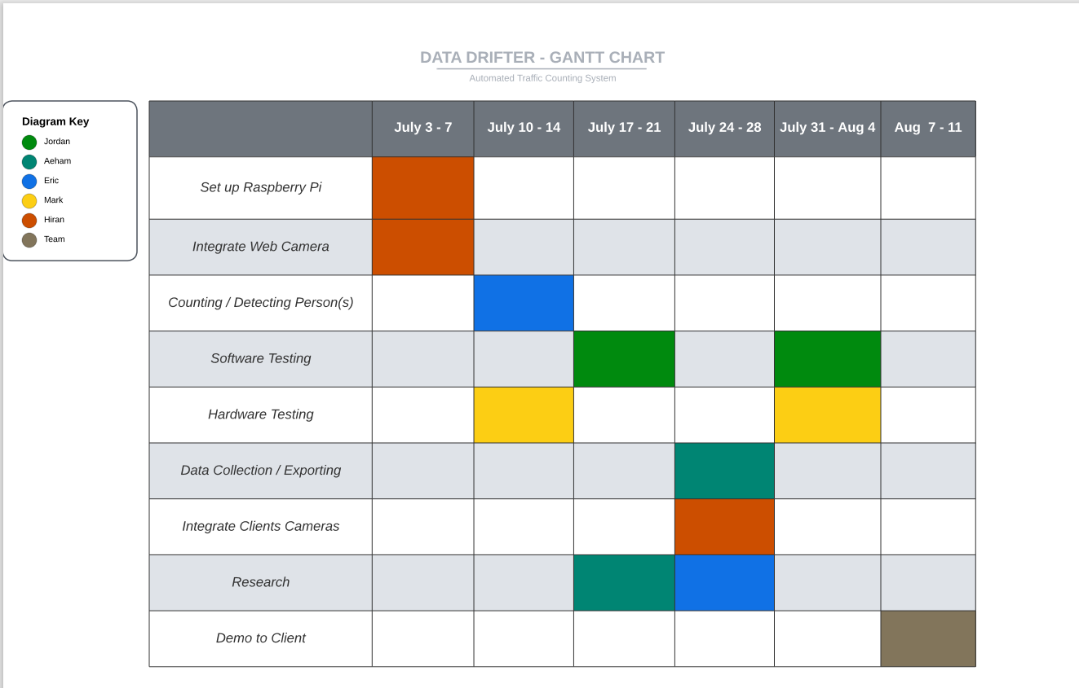
Gantt Chart

Slide 11
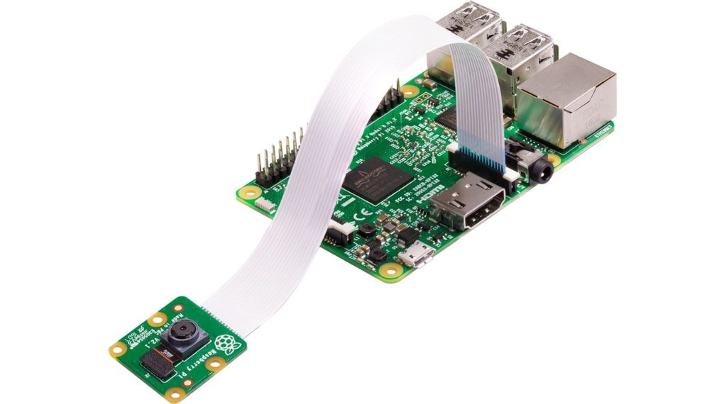
System architecture & design
Raspberry Pi 3B+: Processing Unit and Data Collection Hub
Raspberry Pi 3B+: Central Processing Unit
Serves as the core processing unit of the people counting system.
Coordinates interactions between hardware and software components.
Raspberry Pi Camera Module 3: Capturing Entry Images
Crucial for accurate tracking of individuals entering the makerspace.
Real-time image capture forms the basis for subsequent analysis.
IoT Sensors: Detecting Movement
Vital IoT sensors positioned at entry and exit points.
Detect movement to identify individuals entering and exiting.
Importance of IoT Sensors:
Strategically placed for effective movement detection.
Purpose in the System:
IoT sensors trigger Raspberry Pi 3B+ for tracking.
Ensures responsive system for accurate data capture.

Slide 12
System architecture & design (contd)
z
Raspberry Pi OS & Python Script:
Raspberry Pi 3B+ utilizes the Raspberry Pi OS.
Custom Python script processes data.
Real-time Processing:
Python script handles live video from Raspberry Pi Camera Module 3.
People Counting Calculation:
Advanced algorithms analyze video feed for accurate headcount.
Data Transfer & Desktop Integration:
Data Exchange:
Python script packages people count data.
Desktop Integration:
Secure connection links Raspberry Pi and client's desktop.
Python Script Execution:
Client's desktop receives and processes data.
Excel File Generation:
Processed data compiles into Excel format for daily counts.

Slide 13
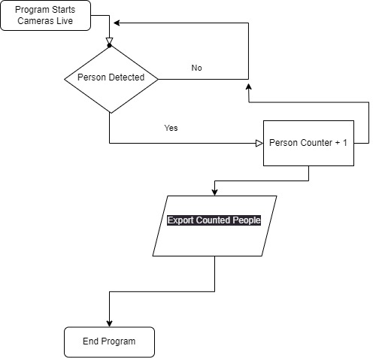
Application Flow

Slide 14
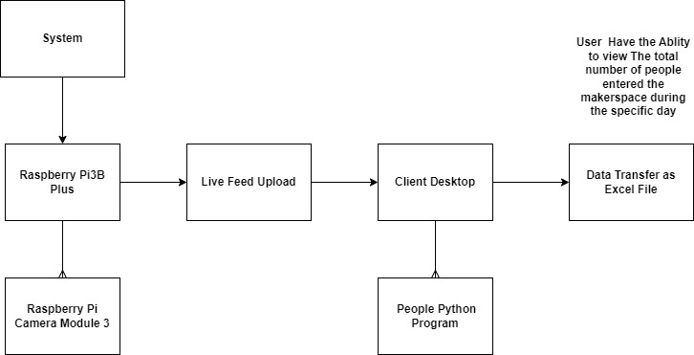
Class Diagram

Slide 15
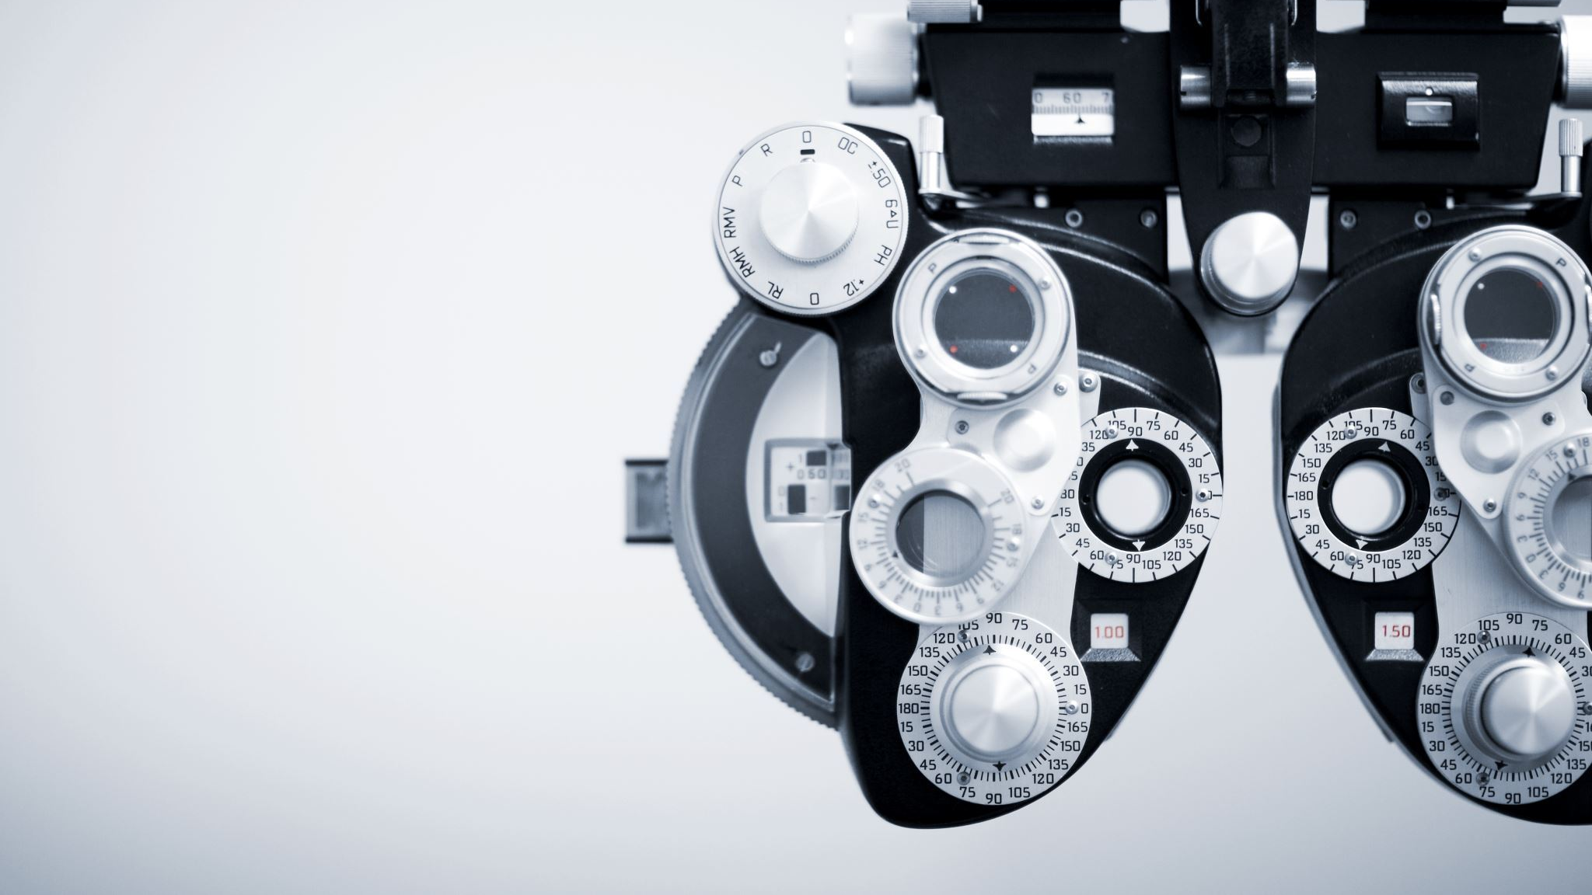
Cycle of Operation (Part1)
Initialization:
Powering On and Initializing:
The system is activated and initialized.
IoT sensors and cameras are ready for operation.
Prepared to detect and track individuals entering and exiting the makerspace.
Detection and Tracking:
Continuous Monitoring:
The system watches entrance and exit points in real-time.
Initiating Tracking:
When someone enters, sensors detect their presence.
Tracking process is initiated.
Image Capture:
Cameras take images or videos for further analysis.

Slide 16
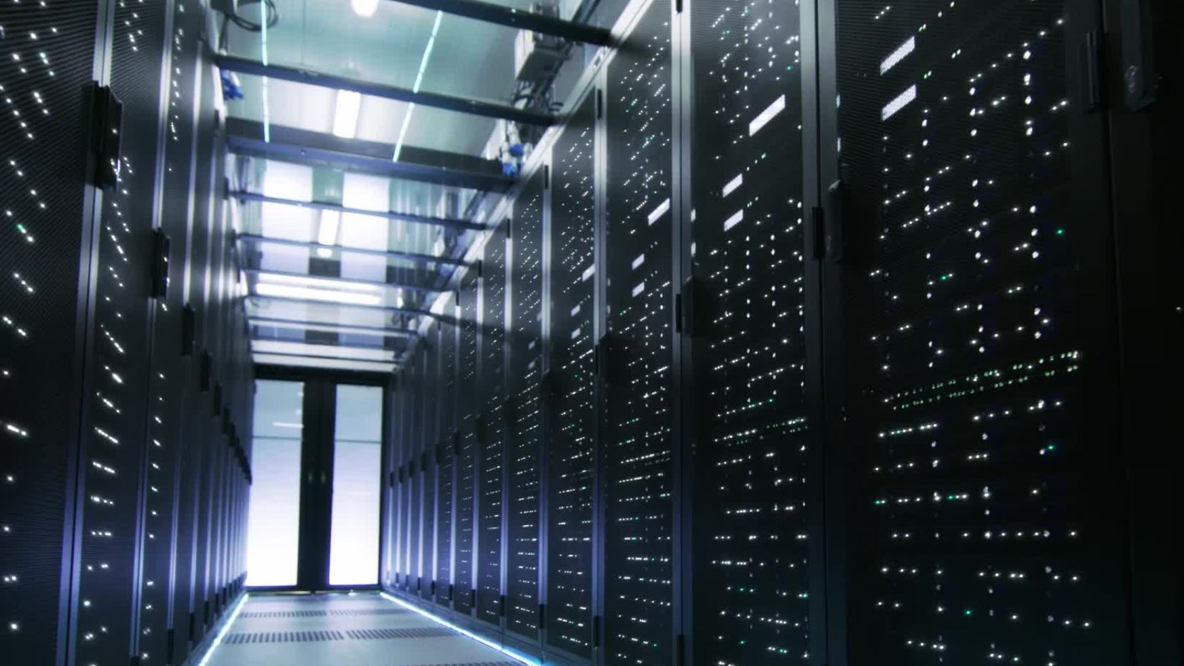
Cycle of Operation (Part1) Contd
Data Collection:
Gathering Information:
The system collects data on entries and exits.
IoT sensors and cameras record timestamps and metadata for each event.
Image Processing and Analysis:
Leveraging Computer Vision:
Captured images/videos undergo computer vision processing.
Object Detection and Tracking:
Advanced algorithms identify individuals.
Counting Uniqueness:
Data is analyzed to ensure accurate and unique people counting

Slide 17

Cycle of Operation (Part 2)
Real-time Monitoring:
Providing Insights:
Users receive real-time occupancy updates.
User Interface Access:
Administrators and users access data via a dashboard.
Accuracy Verification:
Periodic Checks:
System compares its count with manual verification or reliable methods.
Ensuring Precision:
Discrepancies are investigated and addressed for high accuracy.
Timer Functionality:
Tracking Time:
System monitors time.
Midnight Reset:
Counter resets at midnight for a new counting day.
Consistency Check:
Timer functionality is confirmed to avoid disruptions.

Slide 18

Cycle of Operation (Part 2) Contd
Data Export:
Exporting Data:
Users can export data in .CSV format.
Report Generation:
Relevant data fields like timestamps for entry and exit.
Further Analysis:
Data is available for comprehensive analysis.
Reliability and Security:
Ensuring Stability:
System operates reliably with minimal downtime.
Robust Security Measures:
Encryption, access controls, secure communication to protect sensitive data.

Slide 19

Cycle of Operation (Part 2) Contd
User Feedback and Improvements:
User Input Gathering:
Surveys or interviews collect user feedback.
Enhancing User Experience:
Insights shape system improvements.
Maintenance and Updates:
Ensuring Performance:
Regular maintenance and system checks.
Adapting to Changes:
Dynamic makerspace adjustments require system update.

Slide 20
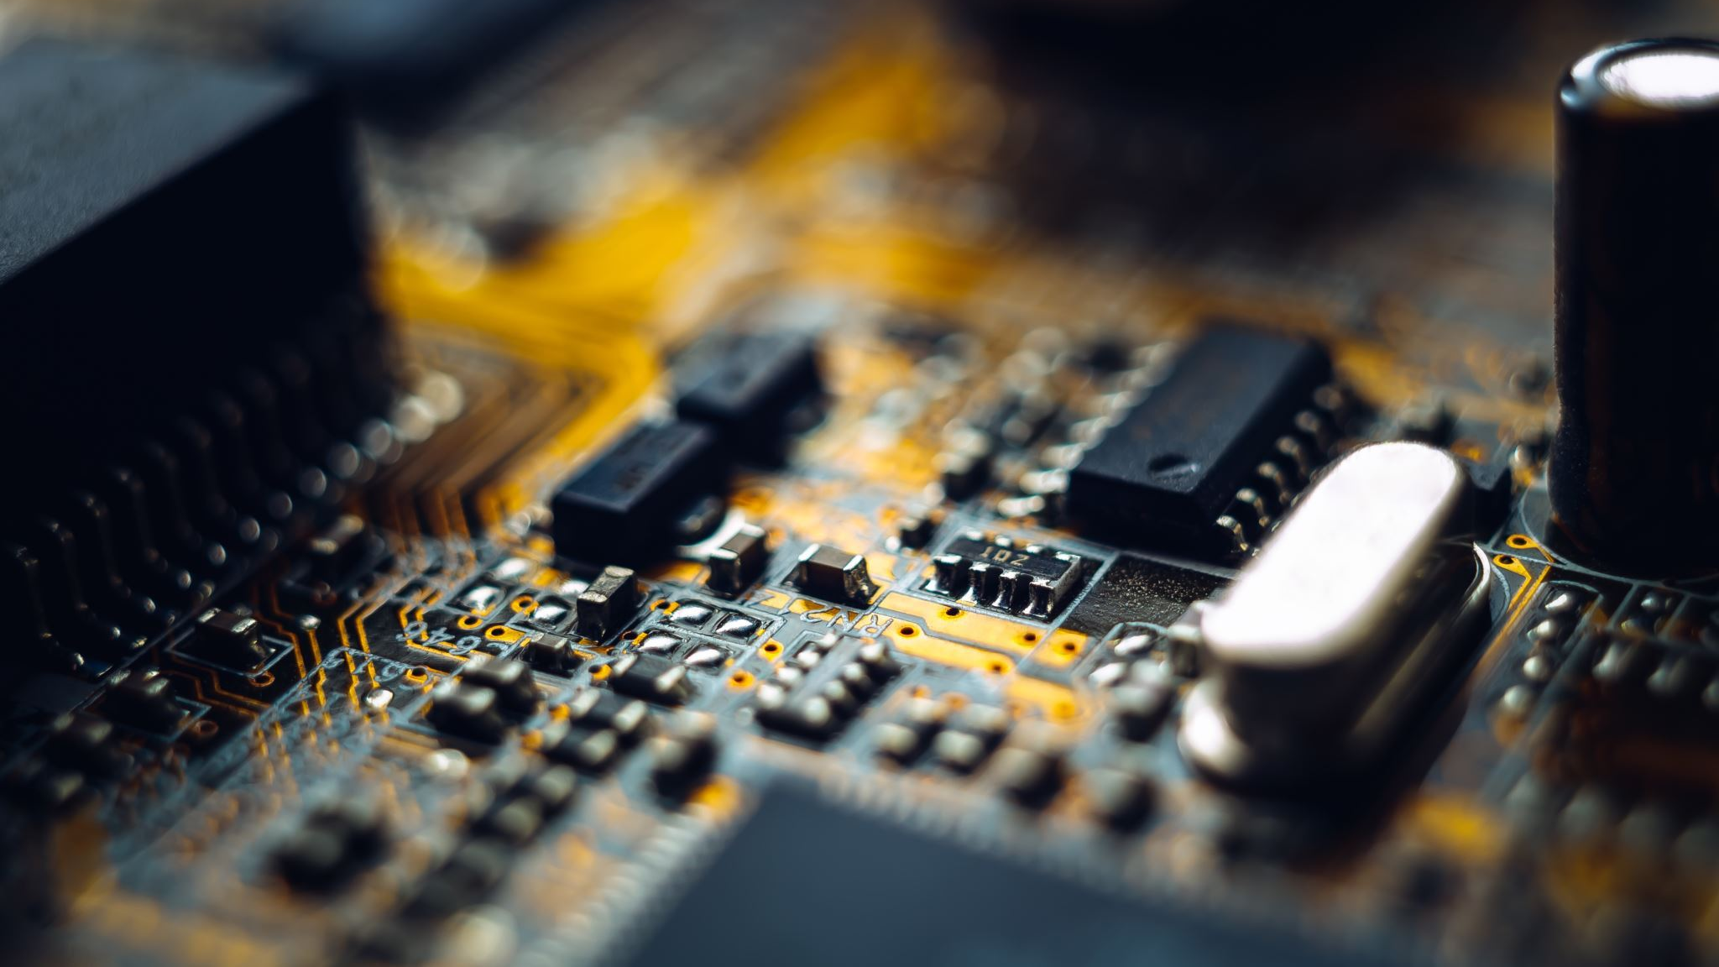
Cost Considerations and Budgeting
Hardware Maintenance Budgeting:
Hardware Maintenance Expenses:
While many aspects of the project leverage free services, hardware maintenance requires allocation of resources.
Hardware components like Raspberry Pi devices, cameras, and IoT sensors may require occasional maintenance, repairs, or replacements.
Budgeting Strategy:
Resource Allocation for Hardware:
Set aside a budget specifically for hardware maintenance.
Anticipate costs related to repairing or replacing components as needed.
Cost-Efficient Management:
Budgeting ensures that necessary maintenance doesn't disrupt project operations.
Prioritizing Longevity:
Proper maintenance safeguards the system's durability and continued accuracy.
Risk Mitigation:
A dedicated maintenance budget helps mitigate unexpected hardware-related issues.

Slide 21
Addressing Challenges and Limitations
Environmental Factors:
Mitigate challenges posed by poor lighting, crowded areas, and obstructions.
Implement solutions to handle dynamic changes in space layouts.
Privacy Concerns:
Obtain proper consent for data collection.
Comply with regulations regarding data usage and storage.

Slide 22
Cost Considerations and Budgeting Contd.
Cost-Effective Hardware Maintenance:
Preventive Maintenance:
Regular checks and upkeep extend hardware lifespan, reducing replacement frequency.
Timely Repairs:
Allocating resources for quick repairs minimizes downtime and interruptions.
Component Replacement:
Budgeting allows for the purchase of replacement parts when necessary.
In Conclusion:
Prudent Hardware Management:
While most services are cost-free, budgeting for hardware maintenance ensures smooth system operation.
Investing in Reliability:
Allocating resources for hardware upkeep supports long-term functionality and project success.

Slide 23

Future Plan
As we continually test and tweak our software, our main goal is to achieve 100% accuracy in our counting system with exported data in the form of CSV excel files. Once were confident in our testing; we plan to add Graphical user interface to display our results. If time permits us to do so. For now, csv files will be more than enough to view the data.

Slide 24
Conclusion
Using Raspberry Pi and IoT, our system accurately monitors daily occupancy in the MakerSpace room through cameras and a Python script. It provides real-time data, supports data-driven decisions, and offers features like individual tracking and .CSV exports. With an emphasis on user experience, feedback-driven refinements ensure ease of use. This solution optimizes makerspace resource management and boosts efficiency.

Slide 25


References
https://www.raspberrypi.com/products/raspberry-pi-3-model-b-plus/
https://www.raspberrypi.com/products/camera-module-3/
https://www.raspberrypi.com/documentation/computers/configuration.html
https://www.raspberrypi.com/software/

Slide 26

Thank You

